Slide 1
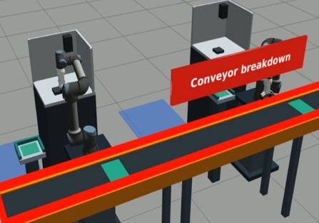
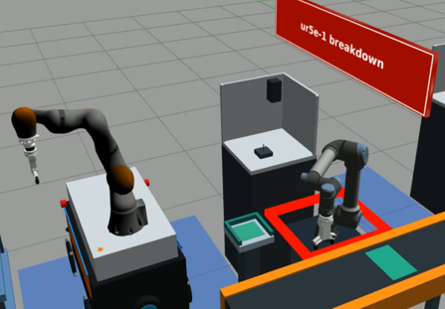
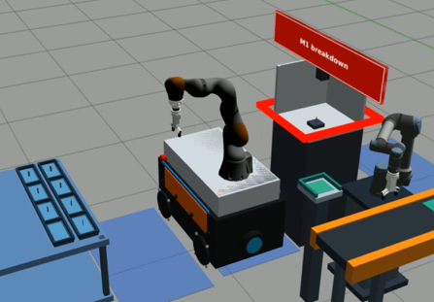
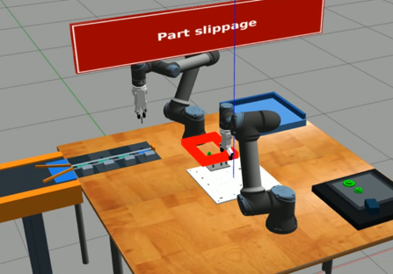
1
Conveyor breakdown
2
ur5e-1 breakdown
Failed
Conveyor
Failed
UR5e-1
Injected UR5e-1 holds the trimmed peg, before release onto the Conveyor
At failure KET4_Square_4mm in UR5e-1
gear_small in UR5e-4
Disrupted transport to Buffer
Injected M1 has finished; UR5e-1 has approached but not grasped
At failure trimmed KET4_Square_4mm in M1
UR5e-1 stopped in M1's front access, gripper empty
Disrupted M1 unloading
3
Machining breakdown during part processing
4
Part slippage
Failed
M1
Failed
UR5e-4
Injected 18% into M1's 5 s trim job
At failure KET4_Square_4mm partly trimmed in M1
RGOCG4-50_Round_4mm still trimming in M2
Disrupted square trimming at M1
Injected gear_small half lowered onto the Assembly Board
At failure gear_small upright in UR5e-3's region
KET4_Square_4mm held by UR5e-3
Disrupted gear_small placement

